Slide 1


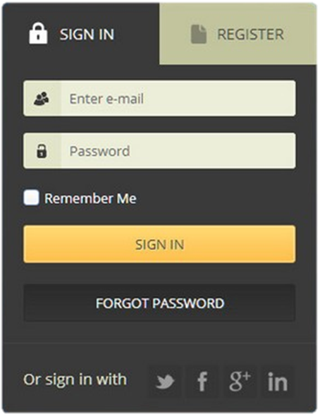

HTML Forms and Styling
Forms, Controls, Fields, Inputs, Submission, Validation
Forms and Styling
SoftUni Team
Technical Trainers
Software University
http://softuni.bg

Slide 2

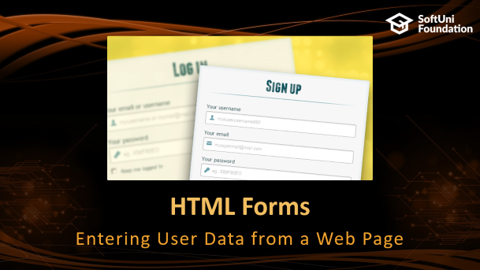
Table of Contents
Table of Contents

Slide 3
Have a Question?
sli.do #front-end

Slide 4
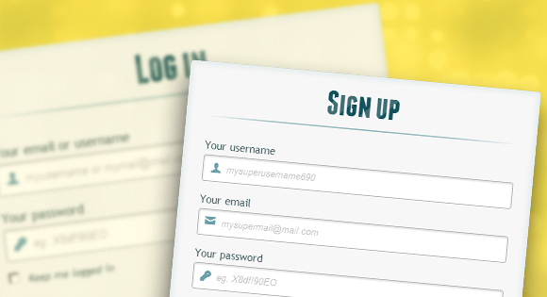
HTML Forms
Entering User Data from a Web Page

Slide 5
HTML Forms: Overview
Create a form block with the <form> tag
method tells how to send form data: HTTP GET or POST request
<form method="post" action="path/to/some-script.php">
<!-- form fields come here -->
<input type="…" name="…" />
</form>
action tells where to send the form data
Learn how to send HTML forms: https://developer.mozilla.org/en-US/docs/Learn/HTML/Forms

Slide 6

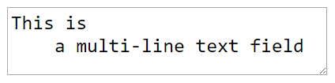

Text Fields
Single-line text input fields:
Multi-line text input fields (textarea):
Password input – masks the text with *
<input type="text" name="firstName" value="Nakov" />
<textarea name="comments">This is a multi-line text field</textarea>
<input type="password" name="pass" />

Slide 7





Buttons
Reset button – resets all form fields
Submit button – sends the form data to the server
Image button – submit button with image
Static button – no default action, used with JavaScript
<input type="reset" />
<input type="submit" value="Apply Now" />
<input type="image" src="go.gif" alt="Submit" />
<input type="button" value="click me" />
<button>Click <b>Me</b></button>

Slide 8
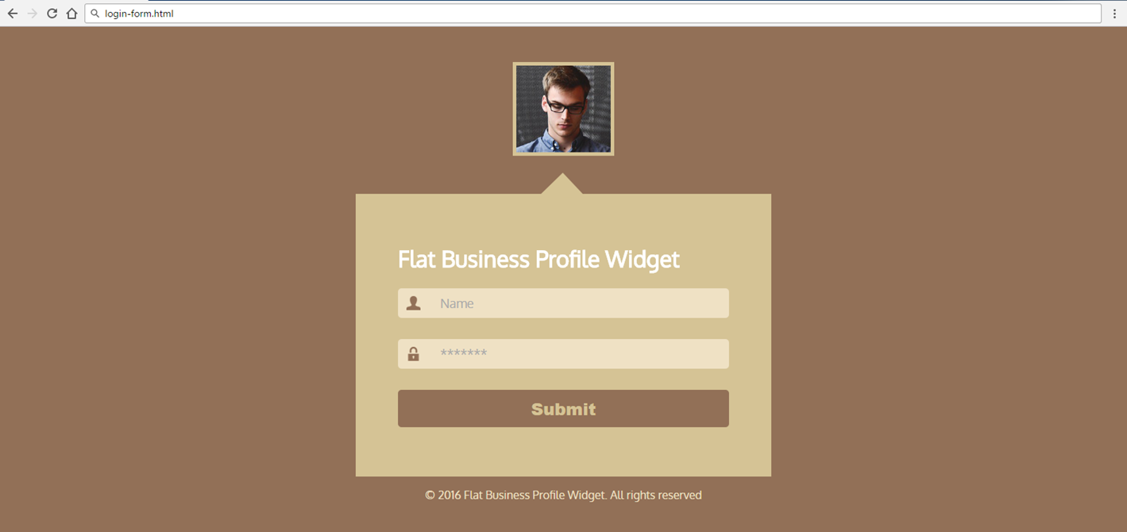
Problem: Login Form (Images)
Create Login Form like the screenshot below
Check your solution here: https://judge.softuni.bg/Contests/409/

Slide 9
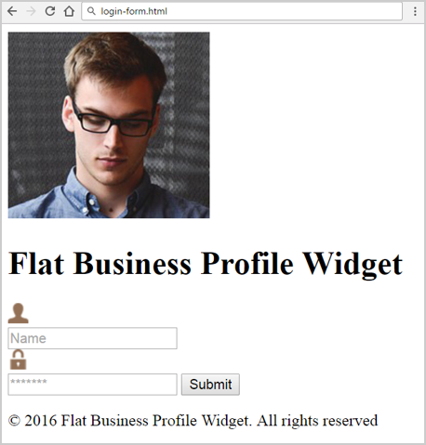
Solution: Login Form (HTML)
<div class="image-container">
<img src="img/image-photo.jpg" alt="photo" />
</div>
<form action="#">
<h1>Flat Business Profile Widget</h1>
<div class="form-field">
<img src="img/user.png" alt="user" />
</div>
<div><input type="text" class="name"
placeholder="Name" />
</div>

Slide 10
Solution: Login Form (HTML) (2)
<div class="form-field">
<img src="img/pass.png" alt="pass" />
</div>
<div>
<input type="password" class="pass"
placeholder="*******" />
</div>
<input type="submit" class="submit" />
</form>
<footer><p>&copy; 2016 Flat…</p></footer>

Slide 11
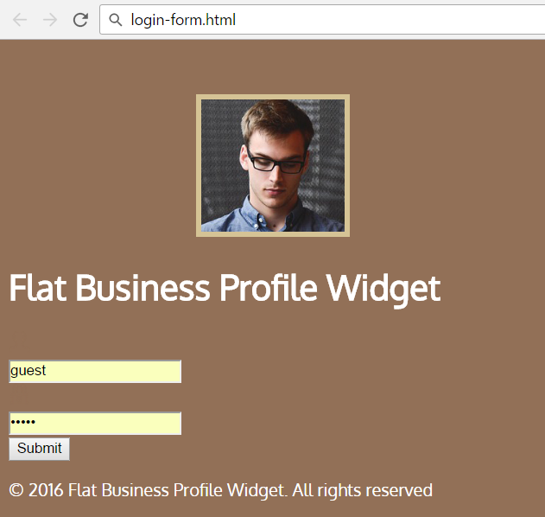
Solution: Login Form (CSS)
@import url('https://fonts.googleapis.com/css?family=Oxygen');
body {
background: #927057;
font-family: 'Oxygen', sans-serif;
color: #ffffff; }
.image-container {
text-align: center;
margin-top: 50px; }
.image-container > img {
border: 5px solid #d5c395;
height: 123px; }

Slide 12
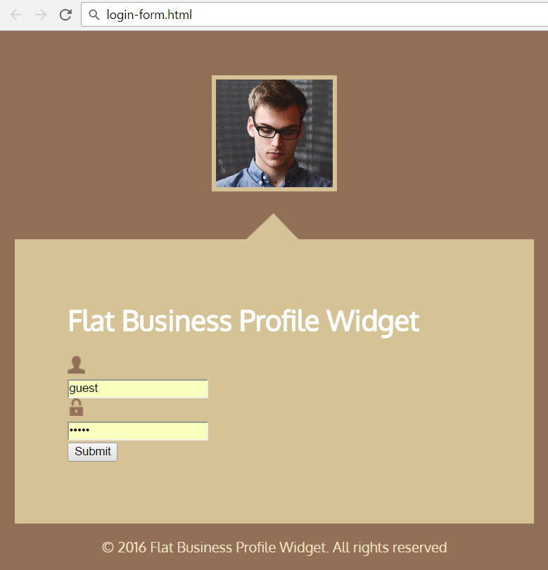
Solution: Login Form (CSS) (2)
form {
position: relative;
width: 470px;
margin: 50px auto 0;
padding: 50px 60px 70px;
background: #d5c395;
}
footer {
font-size: 1em;
color: #EFE1C4;
text-align: center; }
form::before {
position:
absolute;
top: -30px;
left: 259px;
height: 35px;
width: 68px;
background: url(img/3.png) no-repeat 0 0;
content: '';
}

Slide 13
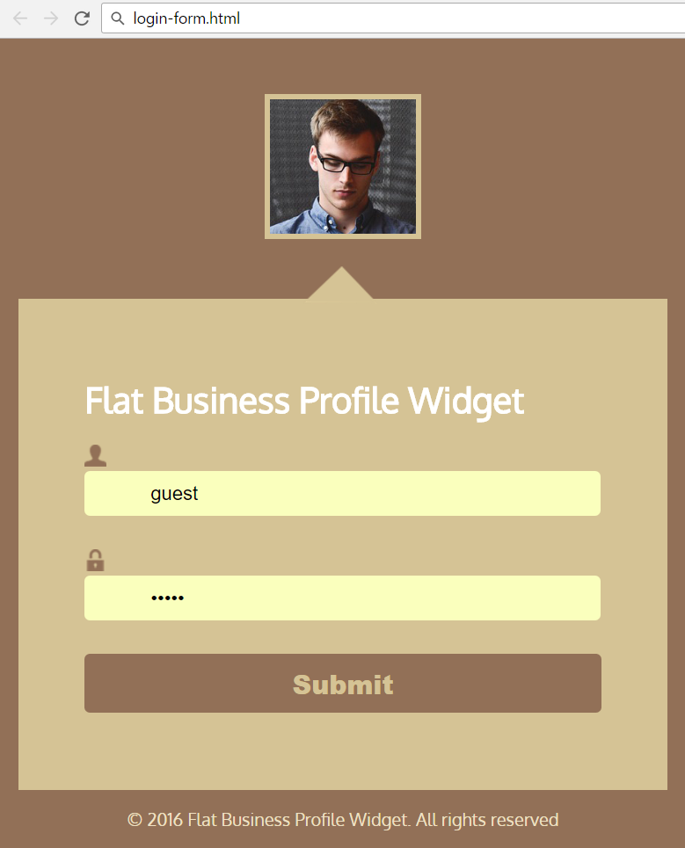
Solution: Login Form (CSS) (3)
.name, .pass {
outline: none;
border: none;
background: #efe1c4;
padding: 10px 10px 10px 60px;
width: 85%;
font-size: 1.1em;
color: #927057;
border-radius: 5px;
margin-bottom: 30px; }
.submit {
outline: none;
border: none;
width: 100%;
padding: 10px;
max-width: 500px;
background: #927057;
color: #d5c395;
font-size: 1.5em;
font-weight: 900;
cursor: pointer;
border-radius: 5px; }

Slide 14
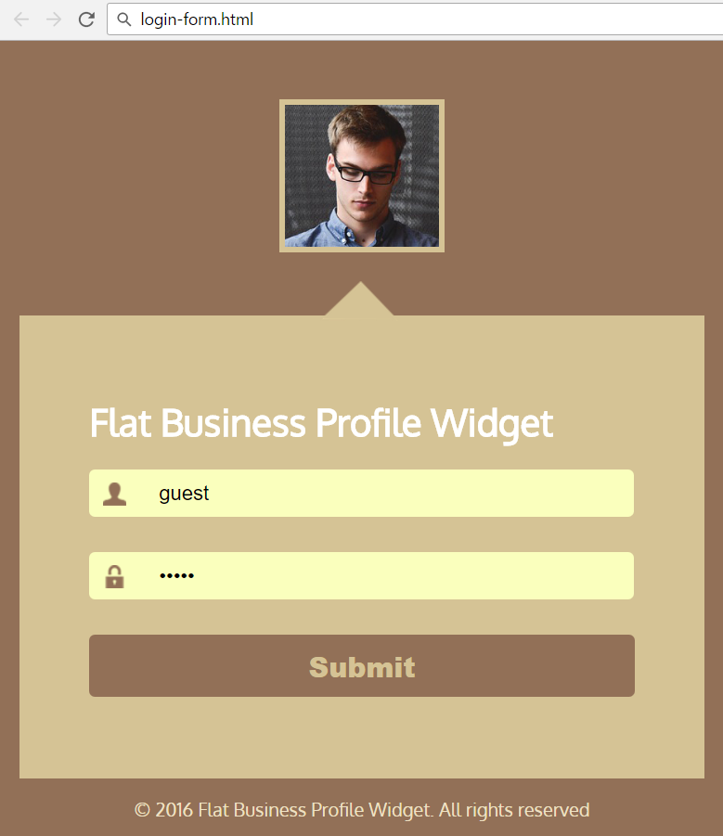
Solution: Login Form (CSS) (4)
.submit:hover {
color: #fae7b0;
box-shadow: 0px 0px 3px #fff;
}
.form-field {
position: relative; }
.form-field > img {
position: absolute;
top: 11px; left: 12px;
width: 20px; height: 20px;
border: none; }

Slide 15
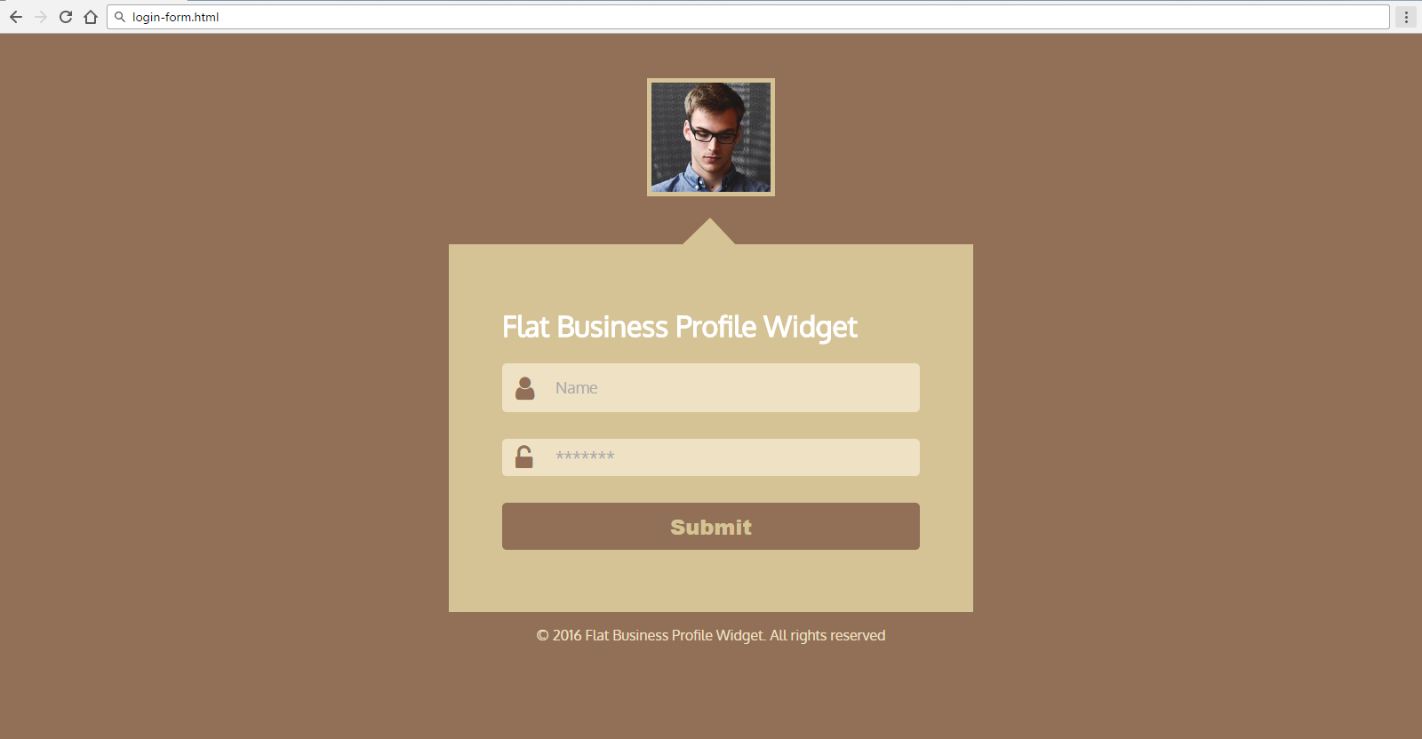
Problem: Login Form (Font Awesome)
Create Login Form like the screenshot below
Use Font Awesome for the form fields icons
Check your solution here: https://judge.softuni.bg/Contests/409/

Slide 16
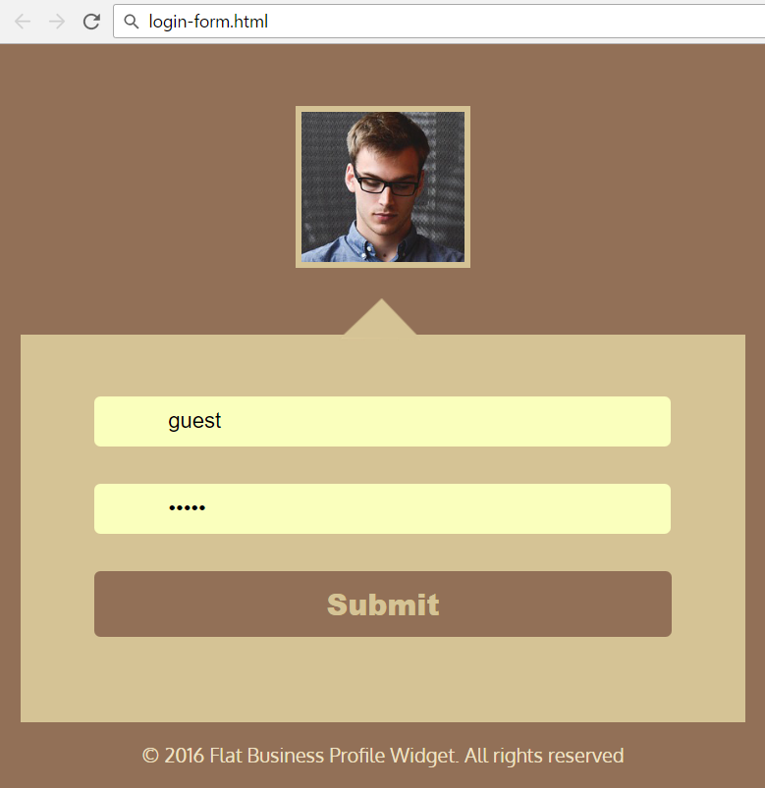
Solution: Login Form (HTML)
<form action="#">
<div class="form-field">
<input type="text" placeholder="Name"
class="name">
<i class="fa fa-user" aria-hidden="true"></i>
</div>
<div class="form-field">
<input type="password" placeholder="*******" class="pass">
<i class="fa fa-unlock-alt" aria-hidden="true"></i>
</div>
<input type="submit" class="submit">
</form>

Slide 17
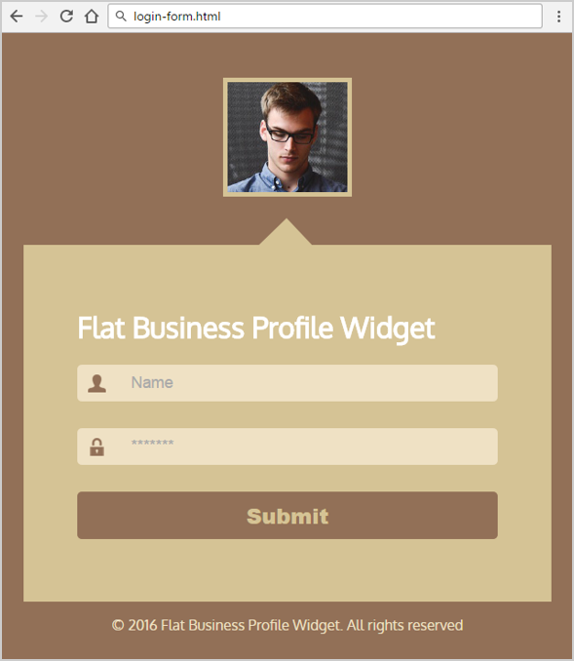
Solution: Login Form (CSS)
.form-field {
position: relative; }
.fa-user {
font-size: 30px;
position: absolute;
top: 5px;
left: 15px;
color: #927057;
}
.fa-unlock-alt {
font-size: 30px;
position: absolute;
top: 7px;
left: 15px;
color: #927057;}

Slide 18
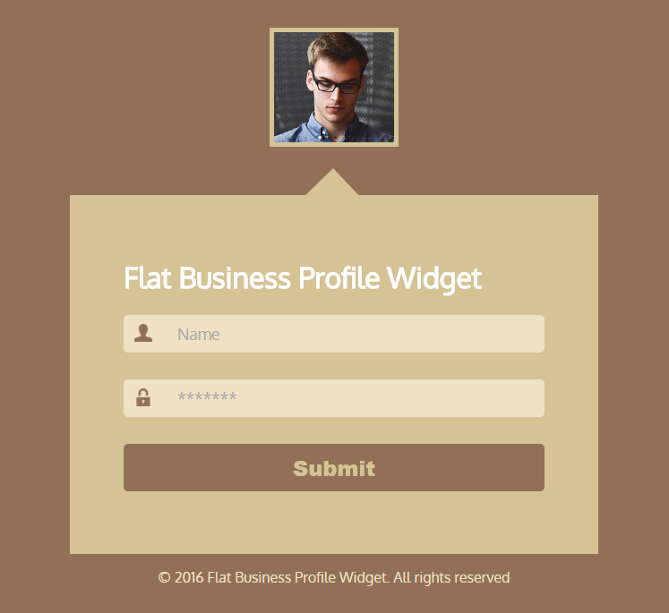
Problem: Login Form (Background Images)
Create Login Form like the screenshot below
Use background images for the icons
Use CSS from the previous problem

Slide 19
Solution: Login Form (HTML)
<form action="#">
<div class="form-field">
<input type="text"
placeholder="Name" class="name">
</div>
<div class="form-field">
<input type="password"
placeholder="*******" class="pass">
</div>
<input type="submit" class="submit">
</form>

Slide 20
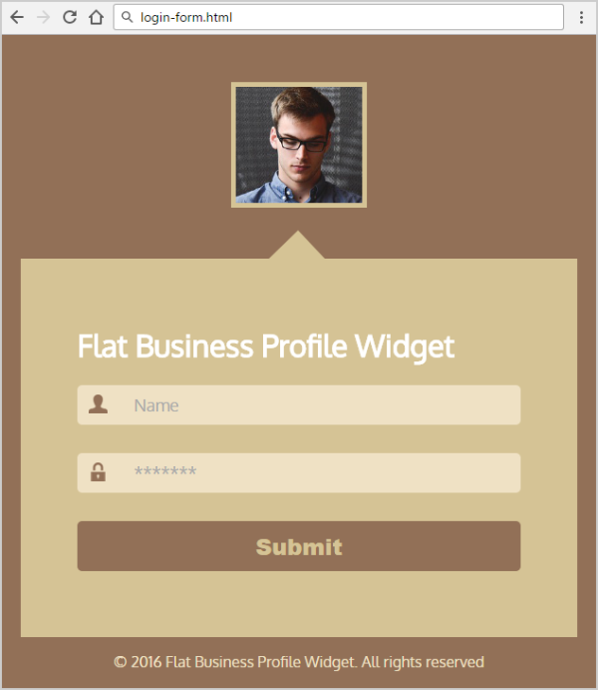
Solution: Login Form (CSS)
.pass {
background: url(img/pass.png) no-repeat 12px 10px #efe1c4;
}
.name {
background: url(img/user.png)
no-repeat 12px 10px #efe1c4;
}

Slide 21

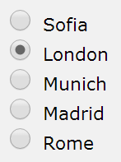
Checkboxes and Radio Buttons
Checkboxes:
Radio buttons in a group named "city":
Only radio button from the group can be selected
<p><input type="checkbox" name="agree"
value="yes">I agree</p>
<input type="radio" name="city" value="1" /> Sofia <br/>
<input type="radio" name="city" value="2" /> London <br/>
<input type="radio" name="city" value="3" /> Munich <br/>
<input type="radio" name="city" value="4" /> Madrid <br/>
<input type="radio" name="city" value="5" /> Rome

Slide 22
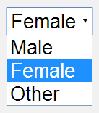
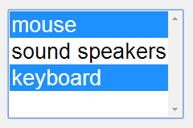
Select / Option Fields
Drop-down list:
Multiple-select list
<select name="gender">
<option value="Value 1">Male</option>
<option value="Value 2" selected="selected">Female</option>
<option value="Value 3">Other</option>
</select>
<select name="products" multiple="multiple">
<option value="202">mouse</option>
<option value="171">sound speakers</option>
<option value="146" selected="selected">keyboard</option>
</select>

Slide 23
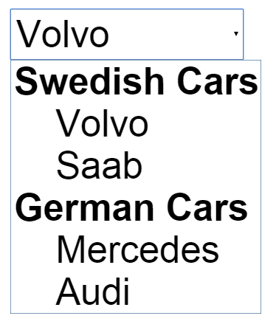
Select / Optgroup
<select>
<optgroup label="Swedish Cars">
<option value="volvo">Volvo</option>
<option value="saab">Saab</option>
</optgroup>
<optgroup label="German Cars">
<option value="mercedes">Mercedes</option>
<option value="audi">Audi</option>
</optgroup>
</select>

Slide 24
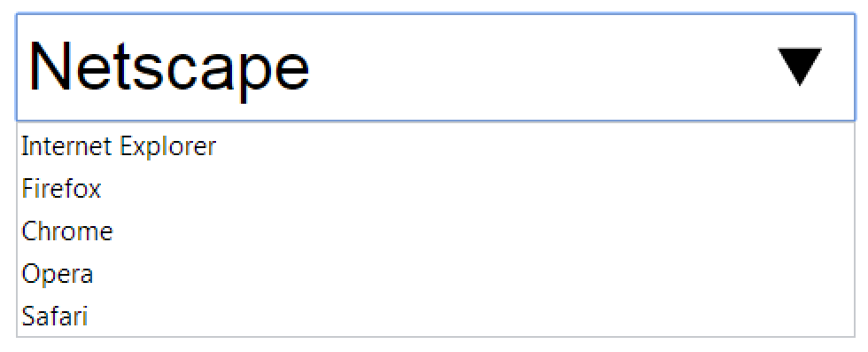
Data List
<input list="browsers" name="browser">
<datalist id="browsers">
<option value="Internet Explorer">
<option value="Firefox">
<option value="Chrome">
<option value="Opera">
<option value="Safari">
</datalist>

Slide 25

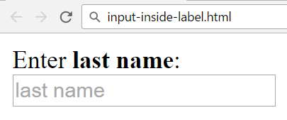
Labels
Labels are associate an explanatory text to a form field
Labels are both a usability and accessibility feature
<label for="fn">First Name</label>
<input type="text" id="fn" placeholder="enter name" />
<label>
<div>Enter <b>last name</b>:</div>
<input type="text"
placeholder="last name" />
</label>

Slide 26
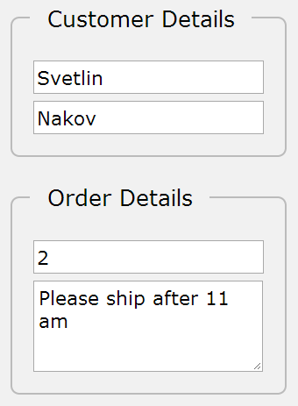
Fieldsets
<fieldset> enclose a group of related form fields:
<form method="post" action="form.php">
<fieldset>
<legend>Customer Details</legend>
<input type="text" name="fName" />
<input type="text" name="lName" />
</fieldset>
<fieldset>
<legend>Order Details</legend>
<input type="text" name="quantity" />
<textarea name="remarks"></textarea>
</fieldset>
</form>

Slide 27
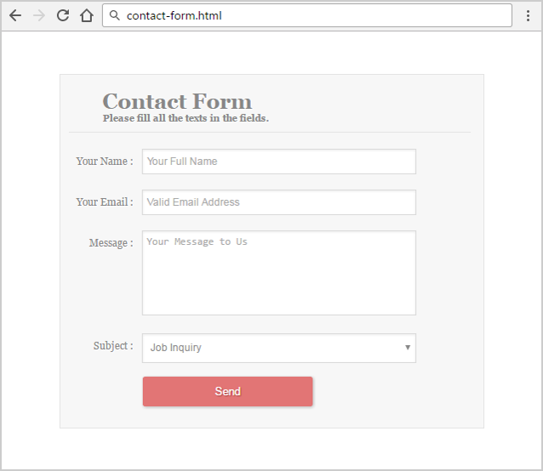
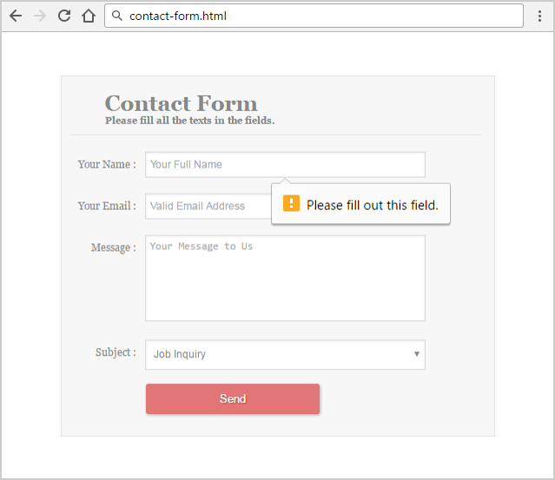
Problem: Contact Form
Create a Contact Form like the screenshot below
Check your solution here: https://judge.softuni.bg/Contests/409/

Slide 28
Solution: Contact Form (HTML)
<form>
<h1>Contact Form<span>Please fill all the texts…</span></h1>
<label>
<span>Your Name:</span>
<input id="name" type="text" name="name" placeholder="Your Full Name" required/>
</label>
<label>
<span>Your Email:</span>
<input id="email" type="email" name="email" placeholder="Valid Email Address" required/>
</label>

Slide 29
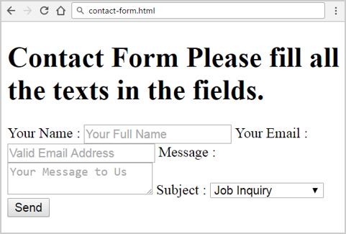
Solution: Contact Form (HTML) (2)
<label>
<span>Message :</span>
<textarea id="message" name="message"
placeholder="Your Message to Us"></textarea>
</label>
<label>
<span>Subject:</span>
<select name="selection">
<option value="Job Inquiry">Job Inquiry</option>
<option value="General Question">General Question</option>
</select>
</label>
<input type="submit" class="button" value="Send" />
</form>

Slide 30
Solution: Contact Form (CSS)
* { box-sizing:border-box; }
form {
margin: 50px auto;
max-width: 500px;
background: #F7F7F7;
padding: 0 15px 25px 10px;
font-size: 12px;
font-family: Georgia,
"Times New Roman",serif
color: #888;
text-shadow: 1px 1px 1px #FFF;
border: 1px solid #E4E4E4; }
h1 {
font-size: 25px;
padding: 0 0 10px 40px;
display: block;
border-bottom:
1px solid #E4E4E4;
color: #888; }
h1 > span {
display: block;
font-size: 11px; }
label {
display: block;
margin: 0; }

Slide 31
Solution: Contact Form (CSS) (2)
label > span {
float: left;
width: 86px;
text-align: right;
padding-right: 10px;
margin-top: 10px;
color: #888; }
input[type="text"], #email, textarea, select {
border: 1px solid #DADADA;
color: #888;
height: 30px;
margin-bottom: 16px;
margin-right: 6px;
margin-top: 2px;
outline: 0 none;
padding: 3px 3px 3px 5px;
width: 323px;
font-size: 12px;
line-height: 15px; }
textarea {
resize: none;
padding: 5px 3px 3px 5px;
height: 100px; }

Slide 32
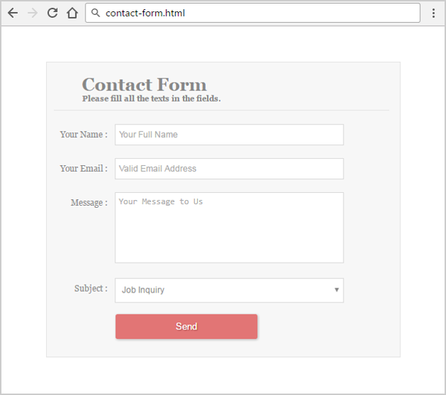
Solution: Contact Form (CSS) (3)
select { height: 35px; }
.button {
background: #E27575;
border: none;
padding: 10px 25px 10px 25px;
color: #FFF;
box-shadow: 1px 1px 5px #B6B6B6;
text-shadow: 1px 1px 1px #9E3F3F;
border-radius: 3px;
cursor: pointer;
margin: 0 87px;
width: 200px; }

Slide 33




Range and Spinbox
Range / number inputs restricts users to enter only numbers
Additional attributes min, max, step and value
Can become spinbox or slider, depending on the input type
May be displayed differently on different browsers
May not work in some browsers (shown as normal text-boxes)
<input type="range" min="0" max="100" />
<input type="number" min="0" max="100" />

Slide 34

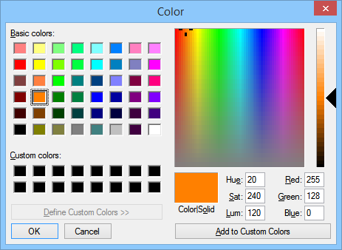
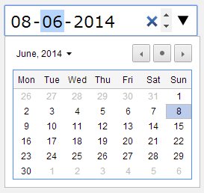


Other Input Types
Color picker
Date picker
Time picker
Date & time picker (combined)
<input name="backgroundColor" type="color" />
<input name="startDate" type="date" />
<input name="arrivalTime" type="time" />
<input name="departure" type="datetime-local" />

Slide 35
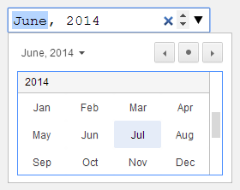
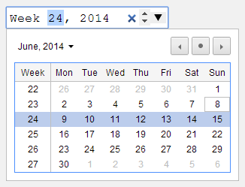


Other Input Types (2)
Month + year selection
Week of the year selection
File upload
Search box
<input name="logo" type="month" />
<input name="start" type="week" />
<input name="start" type="file" />
<input name="searchQuery" type="search" />

Slide 36


HTML Forms
Create and edit input fields

Slide 37

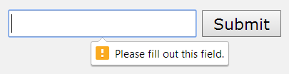
Field Attributes for All Field Types
<input type="text" name="fName" autocomplete="on" />
Autocomplete
Keep the previously typed values
Readonly – the field value cannot be changed
Autofocus
The field becomes on focus on page load
Required
The field is required to be filled / selected
<input type="text" name="firstName" autofocus="autofocus" />
<input type="text" required="true" />

Slide 38
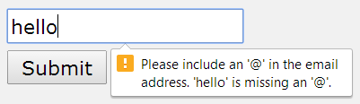
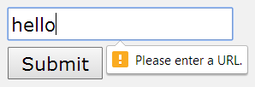

Input Fields with Validation
Email – simple validation for emails
URL – validation for URL addresses
Telephone – validation for phone numbers
<input type="email" required="true" />
<input type="url" required="true" />
<input type="tel" required="true" />

Slide 39
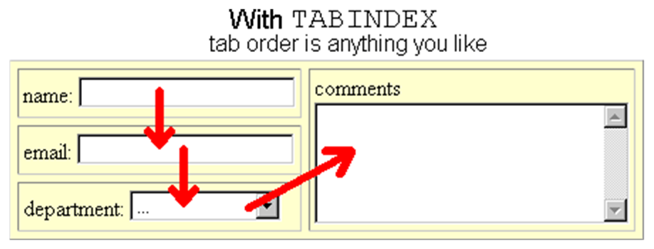
Tab Index
The tabindex controls the order in which form fields and hyperlinks are focused when pressing the [TAB] key
<input type="text" name="second" tabindex="10" />
<input type="text" name="first" tabindex="5" />

Slide 40
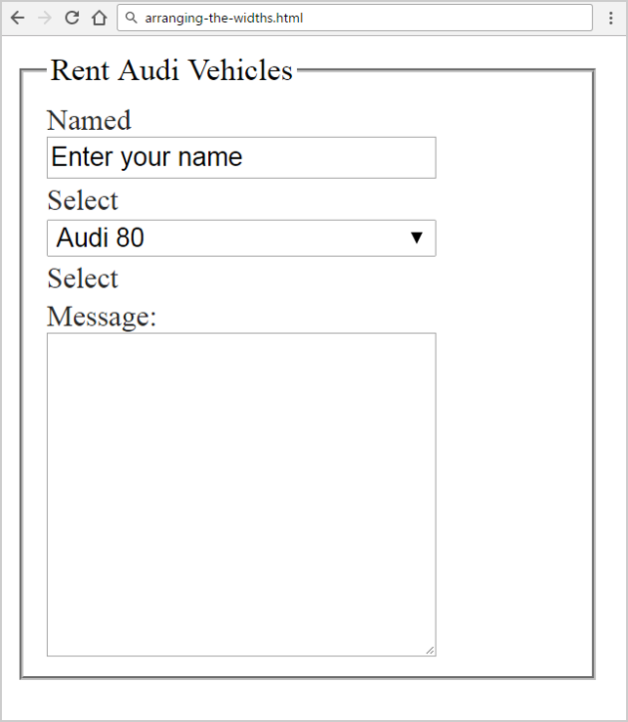
Problem: Arranging the Widths
Check your solution here: https://judge.softuni.bg/Contests/409/

Slide 41
Solution: Arranging the Widths (HTML)
<form action="#">
<fieldset>
<legend>Rent Audi Vehicles</legend>
<label for="name"> Named</label>
<input type="text" value="Enter your name" id="name">
<label for="select">Select</label>
<select id="select">
<option>Audi 80</option>
<option>Audi 90</option>
<option>Audi RS 6</option>
<option>Audi S8</option>
</select>

Slide 42
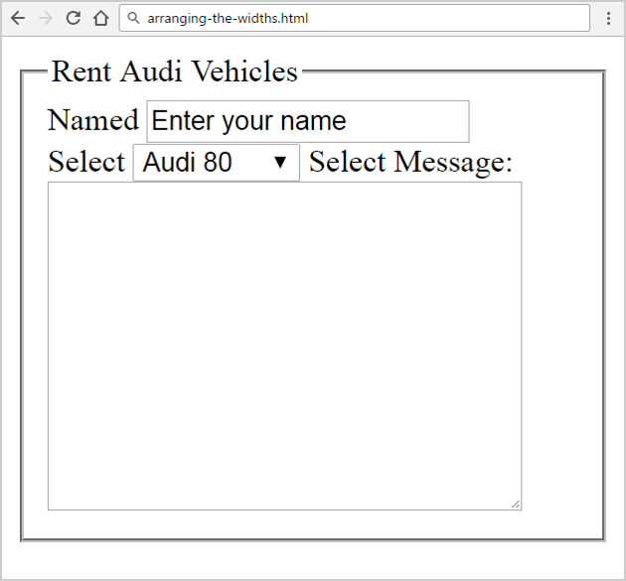
Solution: Arranging the Widths (HTML) (2)
<label>
Select
</label>
<label for="text">
Message:
</label>
<textarea name="name" id="text"
cols="30" rows="10"></textarea>
</fieldset>
</form>

Slide 43


Solution: Arranging the Widths (CSS)
form { width: 300px; }
form, input,textarea {
box-sizing: border-box; }
label, input,select,textarea {
display: inline-block;
width: 200px;
vertical-align: middle; }
label {
color: #2D2D2D;
font-size: 15px;
word-wrap: break-word; }
form, input,textarea {
box-sizing: border-box; }

Slide 44


Summary
Summary
HTML Forms
Text Field
Buttons
Checkboxes and Radio Buttons
Select / Option Fields
<form method="POST" action="…"> … </form>
<input type="text"/>
<input type="password"/>
<input type="reset"/>
<input type="submit"/>

Slide 45







Web Fundamentals – Course Introduction
https://softuni.bg/courses/web-fundamentals-html5

Slide 46






SoftUni Diamond Partners

Slide 47






SoftUni Diamond Partners

Slide 48
License
This course (slides, examples, demos, videos, homework, etc.) is licensed under the "Creative Commons Attribution-NonCommercial-ShareAlike 4.0 International" license

Slide 49





Trainings @ Software University (SoftUni)
Software University – High-Quality Education, Profession and Job for Software Developers
softuni.bg
Software University Foundation
http://softuni.foundation/
Software University @ Facebook
facebook.com/SoftwareUniversity
Software University Forums
forum.softuni.bg

